Slide 1
Healthcare Data analysis (Based on Medicare Data)
R-PYTHONS
Julie John, Khushboo Shah, Roopa Reddy, Siva S, Victor Ime

Slide 2

Scope of the project
Essence of the Analysis - To study and analyze if there is any correlation between quality of healthcare (using MIPS and Hospital Rating by Medicare as basis of comparison) and various parameters.
Use of the Analysis – We are going to Expand implications of the analysis in real world scenario.

Slide 3
Key Questions
Is there a change in trend of ratings of hospitals?
Is there a change in trend of ratings for the individual parameters used for hospital rating?
Relationship in proprietorship of hospitals ?
Are the death/mortality rate changing?
Is there any trend in quality of Healthcare provided and its location(State)?
Does experience, gender, speciality impact the quality of Healthcare provided?

Slide 4

Project Flow
Research healthcare data
Load datasets to S3
Clean & format datasets
Merge datasets
Analysis of datasets
Findings
Conclusion

Slide 5
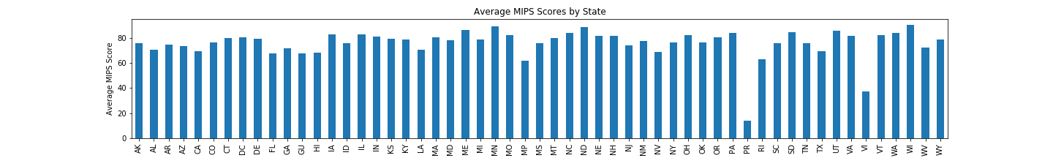
Physician Data Analysis – based on State
WI 90.617209 MN 89.509295 ND 88.888249 ME 86.630244 UT 86.010284

Slide 6
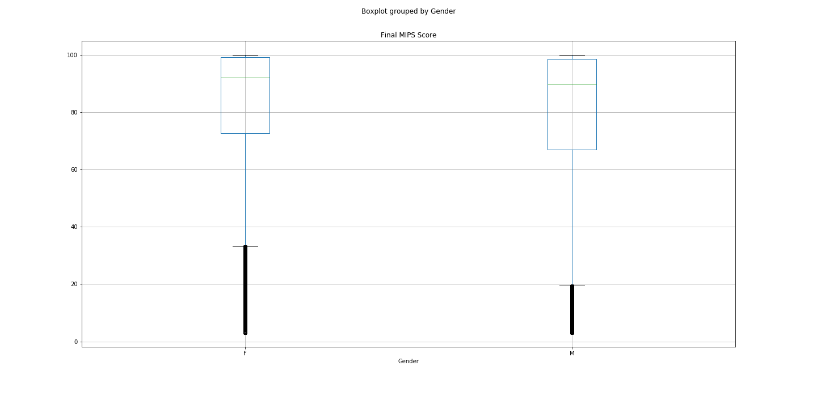
Physician Data Analysis – based on Gender
Hypothesis
Means
Female – 78.55
Male - 76.01
T-test results -
statistic=22.41969156703278,
pvalue=3.526868410040483e-111)

Slide 7
Physician Data Analysis – based on Primary Speciality

Slide 8
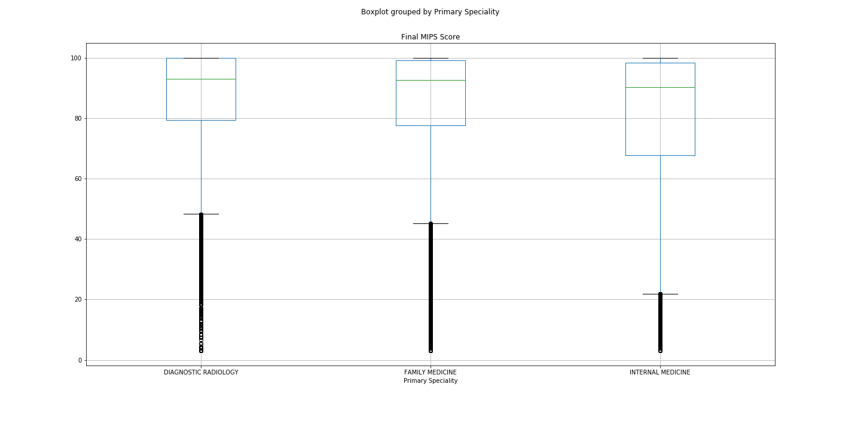
Physician Data Analysis – based on Primary Speciality
Hypothesis –
Conducted Anova Test
F_onewayResult
(statistic=493.71,
pvalue=4.673582850853621e-214)
T-Test
Ttest1-
statistic=-18.58,
pvalue=7.146361368968684e-77
Ttest2
statistic=-33.23
pvalue=1.7647368437515053e-239
Ttest3
statistic=-14.85
pvalue=9.261783102955485e-50

Slide 9
Hospital Rating – data analysis
Finding the trends in parameters used to calculate the overall hospital rating
Number of hospitals rated from 1 star to 5 star
Trend in hospitals rating over four years from 2016 to 2019
Trend in individual parameters that accounted for overall hospital ratings over 4 years from 2016 to 2019
Extracted data for five star rated hospitals
Using GMAPS to locate the five star rated hospitals.
Hospital Data Analysis based on proprietorship

Slide 10
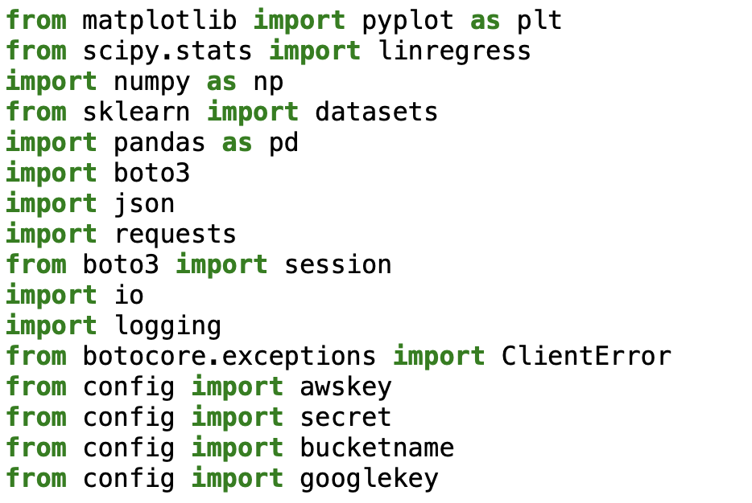
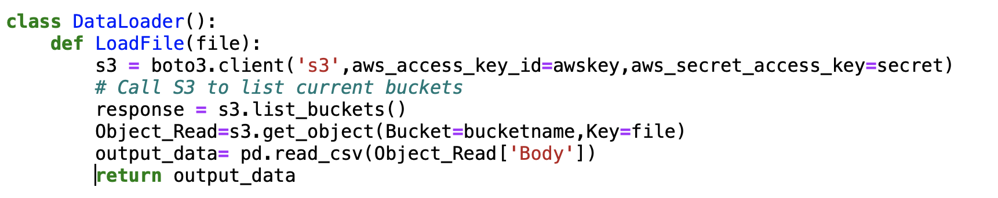
Class DataLoader()

Slide 11
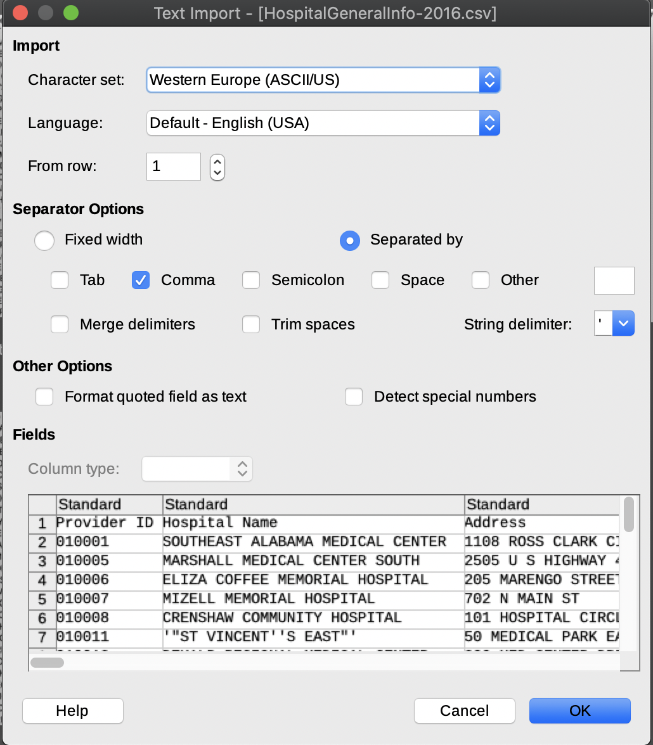
Data Cleanup process – Hospital General Information dataset
Troubleshooting UnicodeDecodeError using LibreOffice
UnicodeDecodeError: 'utf-8' codec can't decode byte 0x92 in position 11: invalid start byte
The columns in the consolidated dataset had "Not Available" values and the rows containing these values were deleted.
Column names were shortened to exclude "national compare" which is redundant among all columns

Slide 12
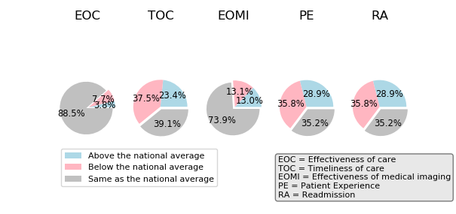
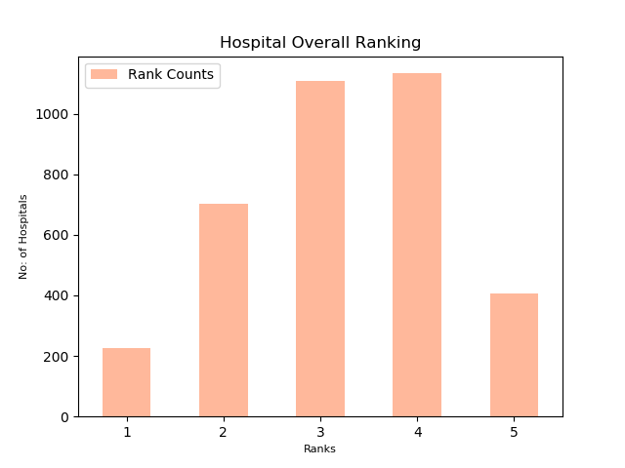
Analysis on Hospital Overall Rating 2019

Slide 13
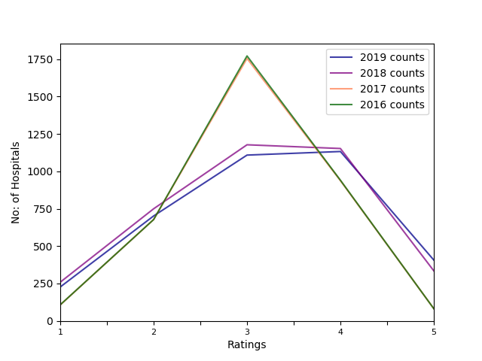
Number of hospitals rated from 2016-2019

Slide 14
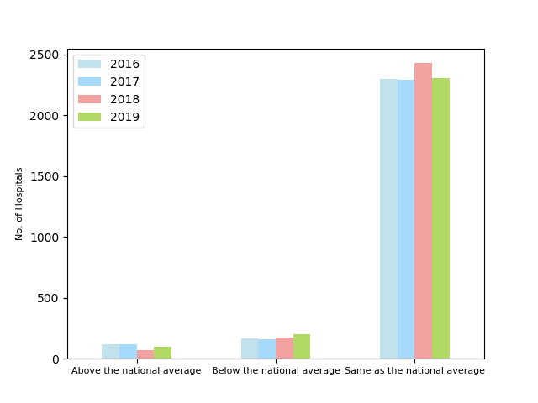
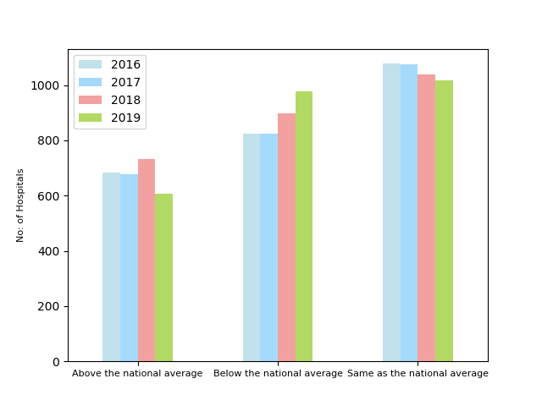
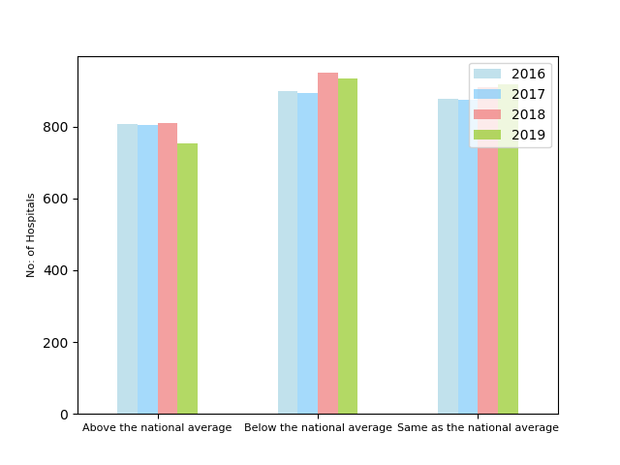
Hospitals rated on individual parameters
Effectiveness of care ratings from 2016 to 2019
Timeliness of care ratings from 2016 to 2019
Patient Experience ratings from 2016 to 2019
Readmission ratings from 2016 to 2019

Slide 15
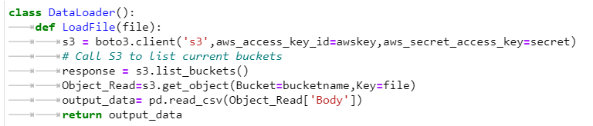
Storage
AWS S3 Object Type Storage
Created a new bucket name “gt-data-analysis-2020”
Created bucket policy and custom policy attached it to a IAM User Gtech User
Gave Programmatic access to the user and download the aws access and secret key
Configured the Key in config.py, used boto3 to establish a connection to s3

Slide 16
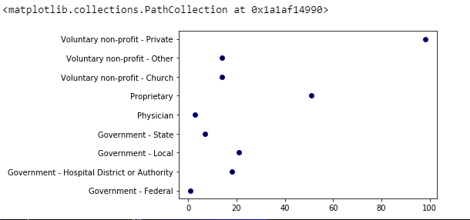
Hospital Data Analysis – Five Star Rated Hospitals
Hospital Data Analysis based on proprietorship
Observation: No of five star rated hospitals are more for private hospitals.

Slide 17
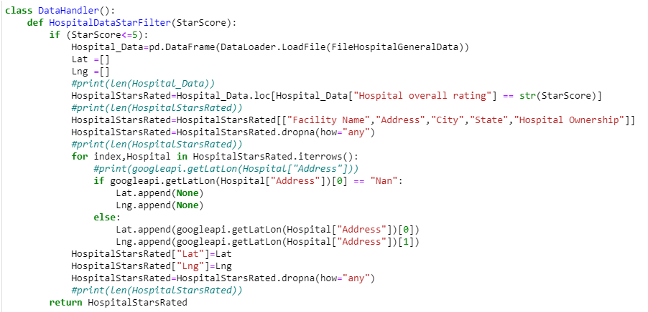
Hospital Data Analysis – Five Star Rated Hospitals
Hospital Data contains Hospital Name, Address and score
Step1. Filter the hospital data for “5” star rating

Slide 18
Hospital Data Analysis – Five Star Rated Hospitals
Hospital Data Analysis based on proprietorship
Observation: No of five star rated hospitals are more for private hospitals.

Slide 19
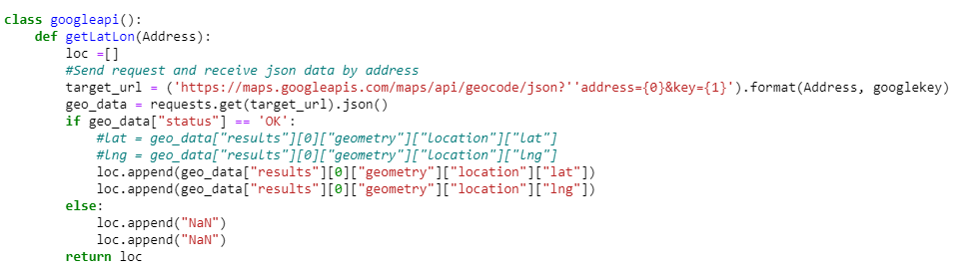
Hospital Data Analysis – Five Star Rated Hospitals
Hospital Data contains Hospital Name, Address and score
Step2. Get the geocode Lat Lon co-ordinates using google API

Slide 20
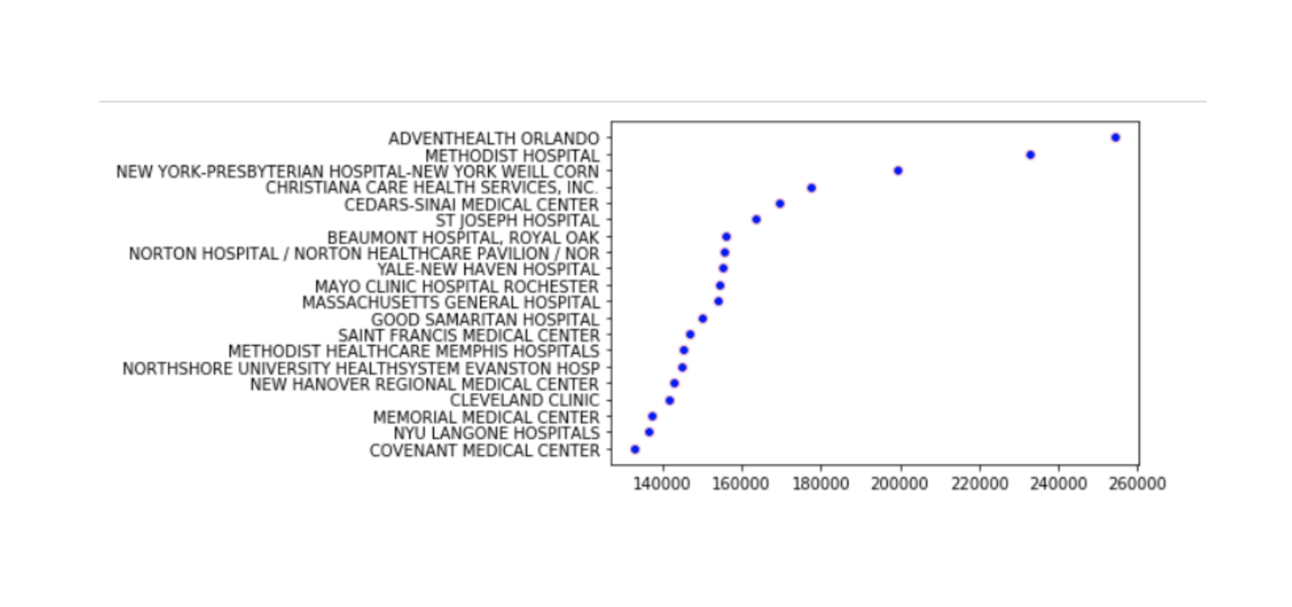
Mortality-Death Analysis

Slide 21
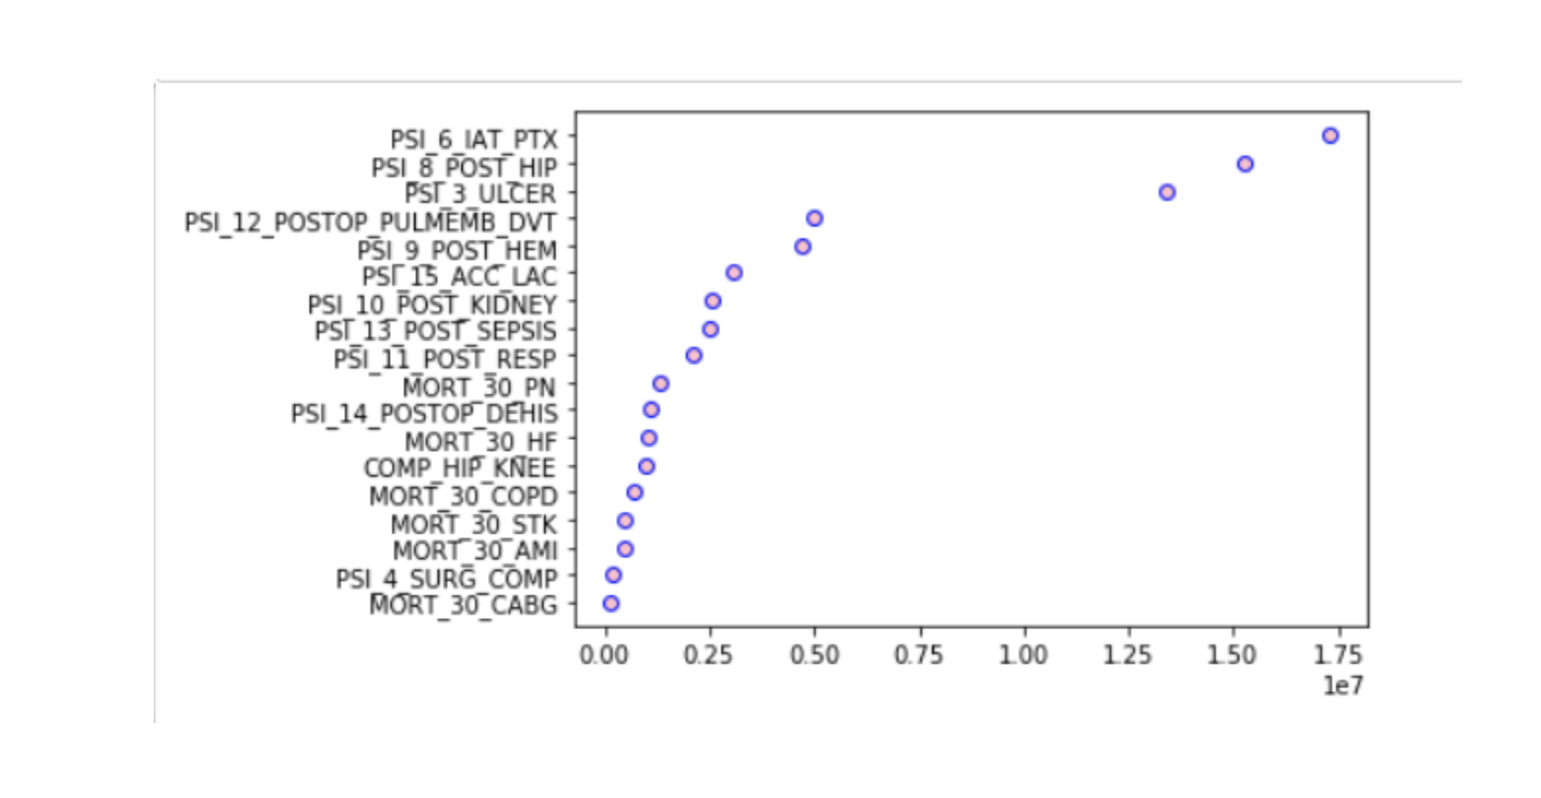
Death Analysis - Reasons for Death
TOP THREE REASONS:
1. Collapsed lung due to medical treatment
2. Broken hip from a fall after surgery
3. Pressure sores

Slide 22
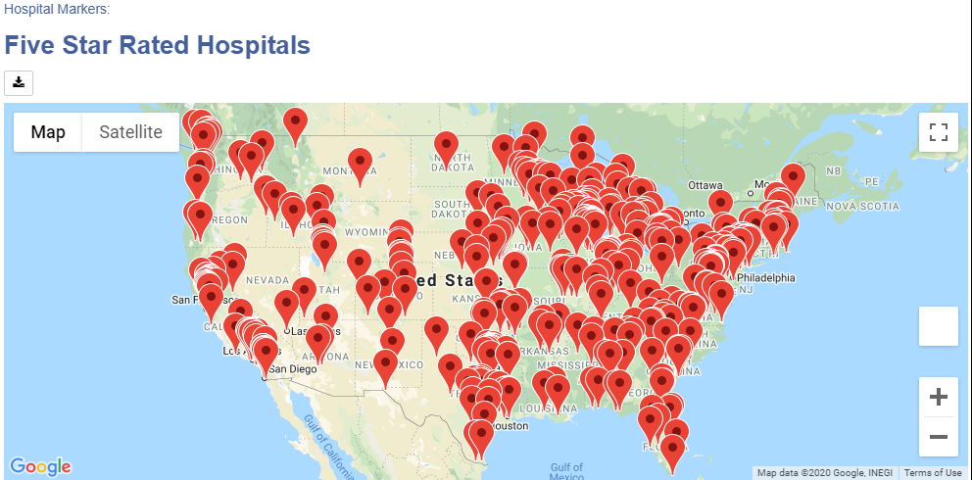
Hospital Data Analysis – Five Star Rated Hospitals
Hospital Data contains Hospital Name, Address and score
Step3. Build Coordinates, and Load the marker layer using GMAPS

Slide 23

Remarks
Potential
These datasets could be analyzed further using more attributes to get more insight and link Physician and Hospital datasets.
A model can be created based on the Analysis which could help physicians to improve their MIPS score and tie them to other reviews like Google, Yelp etc
Limitations
Data is not available for Physicians years for year over year trend analysis
Just specific to Data collected by Medicare

